Slide 1
KESA Monthly Update
March 5, 2024

Slide 2
Our Vision for Kansas ...
Kansas leads the world in the success of each student

Slide 3
Accreditation & Design Team Vision
Each system, fully accredited
Fully accredited - a system that has the 4 Fundamentals in place in each classroom and the results to show that each student has access to a quality learning experience that opens the door to future opportunities.

Slide 4
What is accreditation based on?
Accreditation based on the Four Fundamentals
Accreditation based on Student Outcomes
Accreditation based on Compliance

Slide 5
School Improvement in Kansas
Four Fundamentals
Structured Literacy: Ensuring most effective literacy instruction.
Standards Alignment: Aligning classroom instruction and resources to standards.
Balanced Assessment System: Using data to inform instruction.
Quality Instruction: Promoting quality instruction through high expectations.

Slide 6
Student Outcomes
Lag Measures
PS Effectiveness, HS Graduation, Kansas State Assessments, etc.
Leading Indicators
Interim data, Screener data, Career exploration experiences, etc.

Slide 7
Compliance
2023-2024 KESA Compliance Guide
ACT and WorkKeys Participation
Anti-Bullying Policy and Plan
Child Abuse and Neglect Mandated Reporter Training
Jason Flatt Act
Assessments
Child Nutrition and Wellness
Dyslexia Educator
Mentoring and Induction Plan
Individual Plan of Study (IPS)
KIDS - Data Quality Certified KIDS Reporting
Kindergarten Readiness Snapshot
Licensure
Professional Development Plan
Special Education (IDEA)
Title Services

Slide 8
Topics for this session
Spring 2024 KESA Check-ins
2023-2024 Peer Reviews
KESA 2.0 Build

Slide 9
KESA Check-Ins

Slide 10
KESA Check-ins
Establish a collaborative relationship between each system and KSDE
Create a cadence of consistent support
Learn about each system’s continuous improvement process and the current state of student data
Set the stage for KESA 2.0 beginning in 2024-2025
KESA Check-in slides

Slide 11
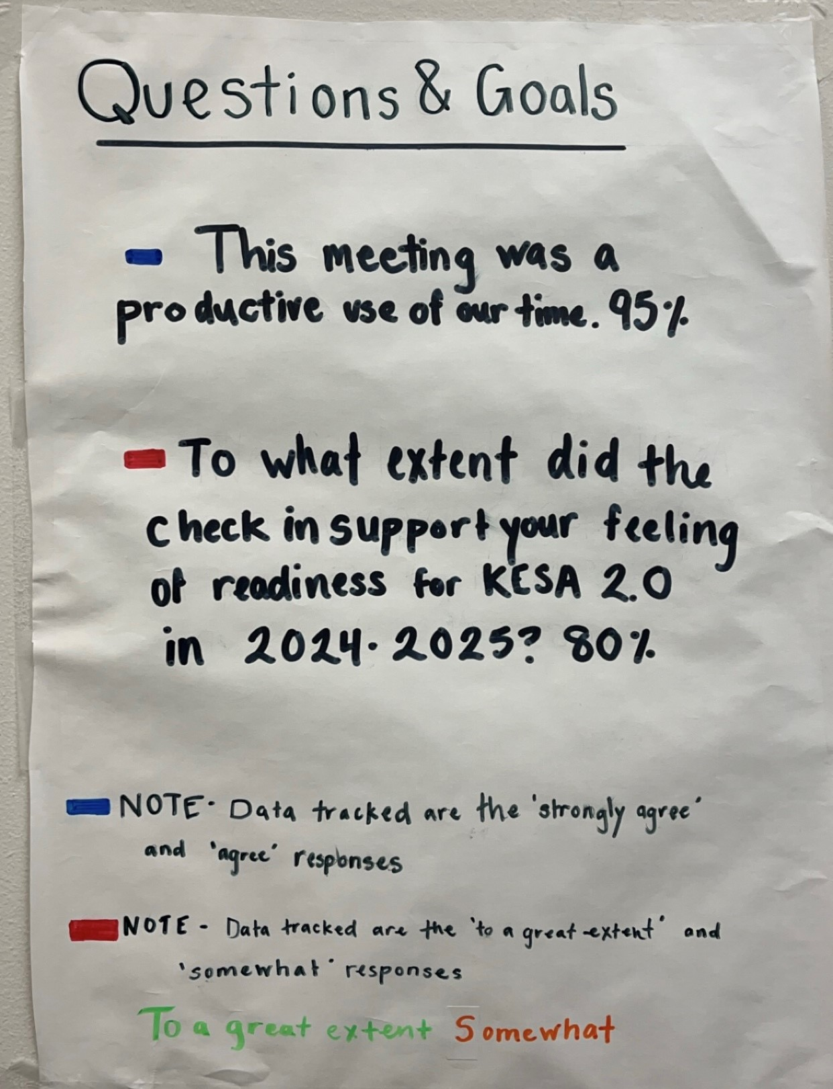
Questions & Goals

Slide 12
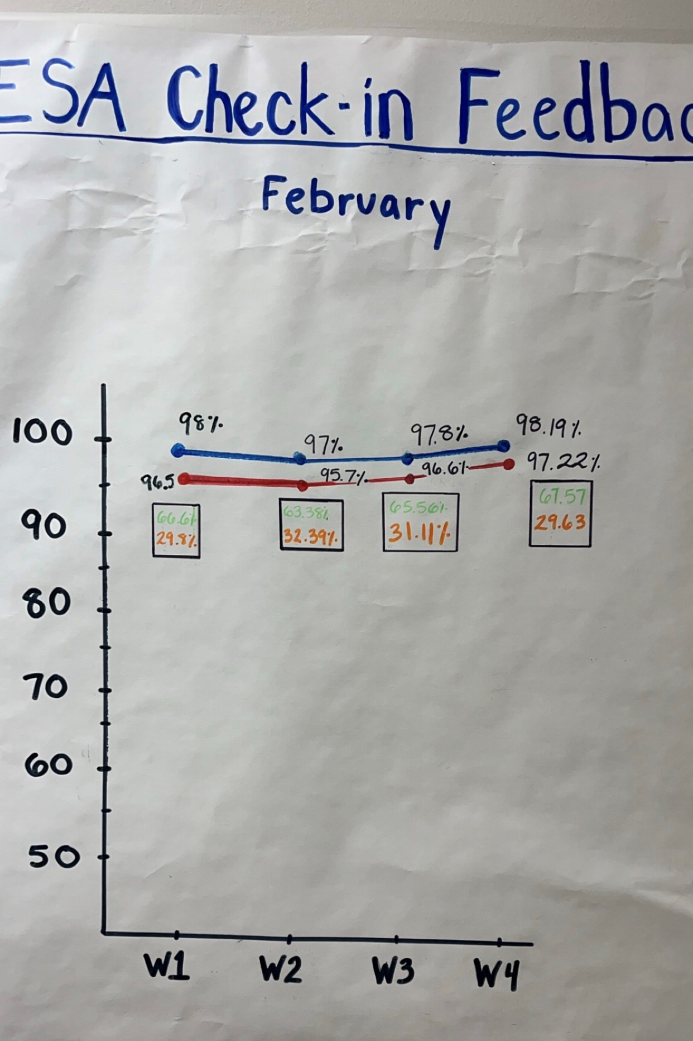
This session was a productive use of our time.

Slide 13
To what extent did the Check-in support your feeling of readiness for KESA 2.0?

Slide 14
FAQ’s from KESA Check-ins
What does the complete model look like?
What constitutes the reporting side of KESA?
Structured Literacy - Secondary level

Slide 15
2023-2024 KESA Peer Reviews
Notes:
Myron

Slide 16
You got options……
Sample Peer Review Agenda

Slide 17
KESA 2.0 Build

Slide 18
KESA 2.0 - The Model
Teachers can clearly see their role in accreditation
Educators’ commitment and responsibility is reinforced by KESA’s external accountability
Action-oriented with annual checks for progress
Actions are:
only a few
research-based
can be supported by KSDE

Slide 19
Kansas School Improvement Model
Example
Interim data
Leading Indicators
Formative and Interim Assessment Dat
Tiered Systems of Support
Walkthroughs
Structures
Standards-aligned
Fundamentals

Slide 20
KESA 2.0 Support Model
Tier 1 (All)
KESA Check-in (1-on-1 between system and A & D team member)
School Improvement Day – peer collaboration with “like” systems on student outcomes and Fundamentals, action planning
Tier 2 (Some)
Additional support facilitated by KSDE
Tier 3 (Few)
Intensive support from the ARC

Slide 21
Priority Projects
Develop the School Improvement Model Structures and Lead Indicators.
Recruit and train facilitators for the peer collaboration, gap analysis, and action planning conversation.
Design the protocol for the deep dive into student performance data.

Slide 22
Priority Projects
Integrate Kindergarten Readiness into the school improvement model and conversation.
Integrate Social and Emotional Learning measured locally into the school improvement model and conversation.
Integrate Individual Plans of Study into the school improvement model and conversation.
Intentional collaboration with Service Center and Technical Assistance Systems Network partners.

Slide 23
Supporting Projects
Kansas Star, Needs Assessment Alignment
Curricular Materials Audit
Standards Alignment Toolkits
Balanced Assessment & Data Literacy
Professional Development and Mentoring Plan Alignment
Higher Education Collaboration and Alignment
STAR Recognition Alignment
The Kansas Vignettes
Civic Engagement Alignment

Slide 24
Q & A
What questions do you have?
Notes:
Jay

Slide 25
Resources
Accreditation Resources (updated)
KESA Regional/Cohort Model of Support
Are you signed up for the KESA listserv? If not, email us at accreditation@ksde.org

Slide 26
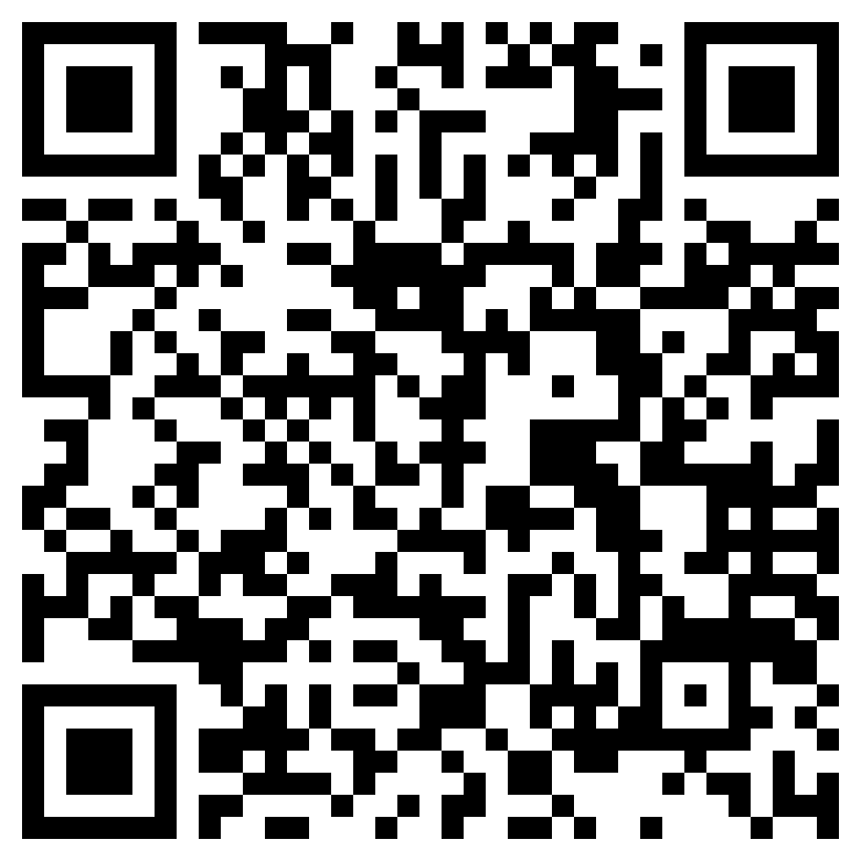
https://forms.gle/ uNUn4iHVoU1d162Y6
Feedback Form
Notes:
Jay

Slide 27
Accreditation & Design
Mindy Bruce, Central Regional Executive
mbruce@ksde.org
Amber Miller, West Regional Executive
amiller@ksde.org
Jean Rush, East Regional Executive
jrush@ksde.org
Myron Melton, Assistant Director
mmelton@ksde.org
Rue Huereca-Retana, Adm. Specialist rhuereca-retana@ksde.org
Jay Scott, Director jscott@ksde.org
accreditation@ksde.org

